Slide 1
Cyberattack Life Cycle Resilience
Ryan Coon
CYB 630
Dr. Hermano Jorge De Queiroz
June 18, 2025

Slide 2
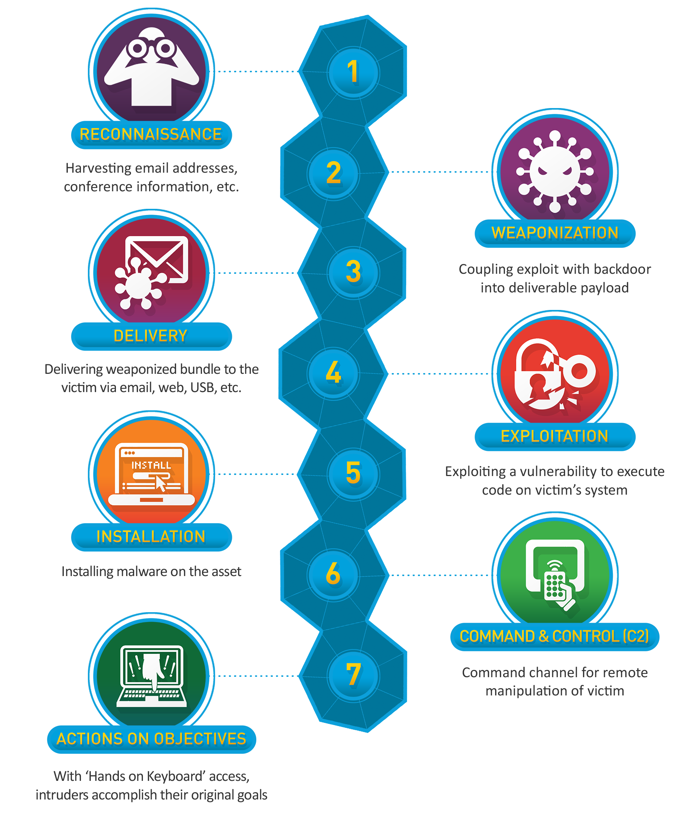
Eight Stages of the Cyber Kill Chain
Reconnaissance - Gathering information about the target.
Weaponization - Creating malicious code or tools.
Delivery - Transmitting the weapon to the target.
Exploitation - Activating the weapon to exploit a vulnerability.
Installation - Installing malicious software or gaining a foothold.
Command and Control (C2) - Establishing a remote control channel.
Actions on Objectives - Executing the attacker’s goal (e.g., data theft, destruction).
Exfiltration/Impact - Stealing, destroying, or disrupting systems/data.

Slide 3
Preventative Measures
Reconnaissance
Weaponization
Implement robust network monitoring to detect suspicious scanning activity. Utilize intrusion detection/prevention systems (IDS/IPS) to identify and block reconnaissance attempts. Regularly update and patch systems to close known vulnerabilities. Employ security information and event management (SIEM) systems to correlate security events and identify potential threats.
Educate employees about phishing and social engineering tactics. Regularly update antivirus and anti-malware software. Implement email filtering and spam protection. Use application control to restrict the execution of unauthorized software.

Slide 4
Preventative Measures
Delivery
Exploitation
Employ strong email security measures, including spam filtering and anti-phishing techniques. Use web filtering to block malicious websites. Regularly patch vulnerabilities in web applications and servers. Implement network segmentation to limit the impact of successful attacks.
Regularly patch software vulnerabilities. Utilize vulnerability scanners to identify and address weaknesses. Implement strong access controls and multi-factor authentication (MFA) to restrict unauthorized access. Employ intrusion detection and prevention systems to monitor network traffic for malicious activity.

Slide 5
Preventative Measures
Installation
Command and Control
Implement application whitelisting to restrict the execution of unauthorized software. Utilize endpoint detection and response (EDR) solutions to monitor system activity for malicious behavior. Regularly back up critical data to prevent data loss in case of an attack.
Implement network segmentation to isolate critical systems. Use firewalls to control network traffic and block unauthorized access. Monitor network traffic for suspicious communication patterns. Regularly review and update security policies and procedures.

Slide 6
Preventative Measures
Actions on Objectives
Exfiltration
Implement data loss prevention (DLP) tools to monitor and prevent sensitive data from leaving the network. Employ access controls to restrict access to sensitive data and systems. Regularly audit system logs to detect unusual activity. Implement security awareness training to educate employees about the importance of data protection.
Implement data loss prevention (DLP) tools to monitor and prevent data from leaving the network. Regularly monitor network traffic for suspicious outbound connections. Employ intrusion detection and prevention systems to identify and block malicious traffic. Use strong encryption to protect sensitive data both in transit and at rest.

Slide 7
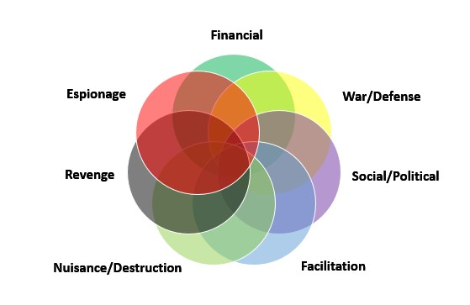
Attacker Motives
Financial Gain: Many cybercriminals are primarily motivated by the potential for financial profit. This can manifest in various ways:
Ransomware Attacks - Attackers encrypt a victim's data and demand a ransom for its release.
Data Theft - Sensitive information, such as credit card details or personal data, is stolen and sold on the dark web.
Fraud - Cybercriminals may engage in identity theft or financial fraud to directly steal money from individuals or organizations.

Slide 8
Attacker Motives
Brand Damage: Some attackers aim to harm an organization's reputation. This can be driven by:
Revenge or Grievance - Disgruntled employees or former employees may seek to damage the brand as a form of retaliation.
Hacktivism - Groups motivated by political or social causes may target organizations they perceive as unethical or harmful, aiming to raise awareness or provoke change.

Slide 9
Attacker Motives
System Access: Gaining unauthorized access to systems can serve various purposes:
Espionage - State-sponsored attackers may seek to infiltrate organizations to steal sensitive information or trade secrets.
Infrastructure Disruption - Some attackers aim to disrupt services or operations, which can be particularly damaging for critical infrastructure.

Slide 10
Attacker Motives
Ideological Motives: Certain attackers are driven by ideological beliefs, targeting organizations that conflict with their values. This can include:
Political Activism - Hacktivists may target government agencies or corporations to promote their political agenda.
Religious Extremism - Some attackers may act out of a desire to promote their religious beliefs or retaliate against perceived enemies.

Slide 11
Attacker Motives
Emotional Factors: In some cases, attackers may be motivated by personal emotions, such as:
Revenge - Individuals may attack organizations or people they feel have wronged them.
Frustration - Some may act out of a desire to express their anger or dissatisfaction with a situation.

Slide 12
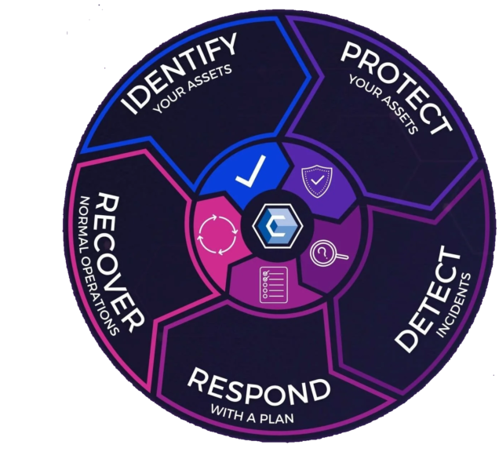
Cybersecurity life cycle, framework, and methodologies
Establishing a comprehensive cybersecurity program requires a multi-faceted approach that integrates the cybersecurity life cycle, a suitable framework (like NIST Cybersecurity Framework), and relevant methodologies. This process would involve a multi phase approach.

Slide 13
Phase 1 Assessment and Planning
Strategic Alignment - Begin by defining the organization's strategic goals and business objectives. Identify critical assets and systems that directly support these objectives. This forms the foundation for prioritizing cybersecurity efforts.
Risk Assessment - Conduct a thorough risk assessment to identify vulnerabilities, threats, and potential impacts on the organization. This assessment should consider both internal and external factors, including regulatory compliance requirements.
Framework Selection - Choose a cybersecurity framework that aligns with the organization's size, industry, and risk profile. The NIST Cybersecurity Framework is a widely adopted option, providing a flexible and comprehensive approach. Other frameworks, such as ISO 27001, can also be considered.
Gap Analysis - Compare the organization's current cybersecurity posture against the chosen framework. Identify gaps and areas for improvement. This analysis will inform the development of the cybersecurity program.
Program Definition - Based on the assessment and gap analysis, define the scope, objectives, and key performance indicators (KPIs) of the cybersecurity program. This should include a clear statement of purpose, roles and responsibilities, and budget allocation.

Slide 14
Phase 2 Design and Implementation
Policy and Procedure Development - Develop comprehensive cybersecurity policies and procedures that align with the chosen framework and address identified risks. These policies should cover areas such as access control, data security, incident response, and security awareness training.
Technology Implementation - Implement appropriate security technologies to address identified vulnerabilities and threats. This may include firewalls, intrusion detection systems, antivirus software, data loss prevention (DLP) tools, and security information and event management (SIEM) systems.
Security Awareness Training - Develop and deliver comprehensive security awareness training programs to educate employees about cybersecurity threats and best practices. This training should be tailored to different roles and responsibilities within the organization.

Slide 15
Phase 3 operation and monitoring
Continuous Monitoring - Implement continuous monitoring and logging to detect and respond to security incidents. This includes regular security audits, vulnerability scans, and penetration testing.
Incident Response - Develop and test an incident response plan to effectively manage and mitigate security incidents. This plan should outline clear procedures for identifying, containing, eradicating, recovering from, and learning from security incidents.
Compliance and Reporting - Ensure compliance with relevant regulations and standards. Regularly report on the effectiveness of the cybersecurity program to management and stakeholders.

Slide 16
Phase 4 review and improvement
Regular Review - Regularly review and update the cybersecurity program to address emerging threats and vulnerabilities. This should include periodic risk assessments, gap analyses, and policy updates.
Continuous Improvement - Implement a continuous improvement process to enhance the effectiveness of the cybersecurity program over time. This may involve incorporating new technologies, improving processes, and enhancing employee training.

Slide 17
Methodologies
Various methodologies can be integrated into this process, such as Agile for iterative development and improvement, and DevOps for integrating security into the software development lifecycle. The specific methodology chosen will depend on the organization's needs and preferences.

Slide 18
references
IBM. (2024). Cost of a data breach report 2024. IBM. https://www.ibm.com/reports/data-breach
Lenaerts-Bergmans, B. (2022, October 13). What Is the Cyber Kill Chain? Introduction Guide | CrowdStrike. Crowdstrike.com. https://www.crowdstrike.com/en-us/cybersecurity-101/cyberattacks/cyber-kill-chain/
Lockheed Martin. (2025). Cyber Kill Chain. Lockheed Martin. https://www.lockheedmartin.com/en-us/capabilities/cyber/cyber-kill-chain.html
Mark, C. (2024, January 6). Understanding cyber attacker motivations to best apply controls. Levelblue.com. https://levelblue.com/blogs/security-essentials/understanding-cyber-attacker-motivations-to-best-apply-controls
NIST. (2024). Cybersecurity Framework. National Institute of Standards and Technology. https://www.nist.gov/cyberframework
SANS. (n.d.). Top 25 Software Errors | SANS Institute. Www.sans.org. https://www.sans.org/top25-software-errors/
Tamang, P. (2022). Cybersecurity Lifecycle. Securesphere.co.nz. https://securesphere.co.nz/index.php/cybersecurity-lifecycle-2/

